Slide 1
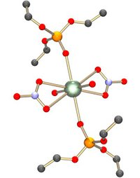
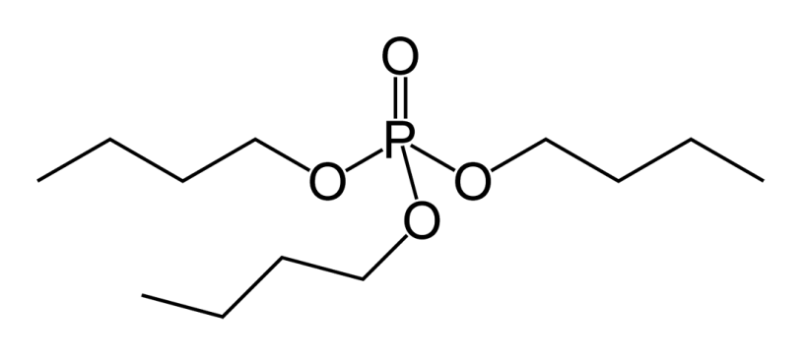

RDCH 702: Lecture 9 Separations Part 4
Separation methods
  Solvent extraction
    PUREX
  Ion exchange
  Volatility
  Electrochemistry
Specific actinide separations
Basic concept of separations
  Oxidation state
  Ionic radius
Development of advanced separations
  Trivalent actinides
Necessary for fuel cycle due to formation of mixtures due to fission
  Actinides
    Transuranics
  Fission products
    Se (Z=34) to Dy (Z=66)
Tributyl phosphate (TBP)

Slide 2
Pu separations
1855 MT Pu produced
  Current rate of 70-75 MT/years
  225 MT for fuel cycle
  260 MT for weapons
Large scale separations based on manipulation of Pu oxidation state
  Aqueous (PUREX)
  Non-aqueous (Pyroprocessing)
Precipitation methods
  Basis of bismuth phosphate separation
    Precipitation of BiPO₄ in acid carries tri- and tetravalent actinides
      Bismuth nitrate and phosphoric acid
      Separation of solid, then oxidation to Pu(VI)
    Sulfuric acid forms solution U sulfate, preventing precipitation
  Used after initial purification methods
  LaF₃ for precipitation of trivalent and tetravalent actinides

Slide 3
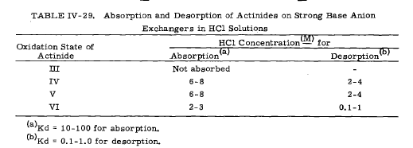
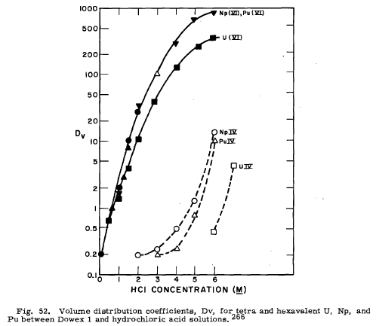
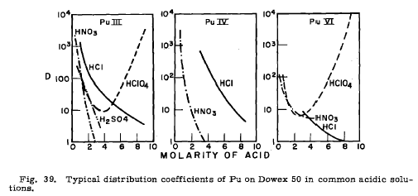
Pu separations
Solvent extraction
  TBP extraction, PUREX process
    Some interest in 3rd phase formation
Extraction chromatography
  Extractant on solid support
Ion-exchange
  Both cation and anion exchange
    Anion exchange based on formation of appropriate species in acidic solution
    Change of solution impact sorption to column
Pu separation
  Sorb Pu(IV,VI) in 6 M acid, reduce to Pu(III)
General cation exchange trends for Pu
  HNO₃, H₂SO₄, and HClO₄ show stronger influence than HCl
  Strong increase in distribution coefficient in HClO₄ at high acidities exhibited for Pu(III) and Pu(VI)
Anion exchanges in high acid, formation of charged species

Slide 4
Pu separations
Halide volatility (PuF₆, PuCl₆)
  PuO₂ in fluidized bed reactor with fluorine at 400° C
    Can substitute NH₄HF₂ for some fluorination
    Also use of O₂F₂
  PuF₆ decomposes to PuF₄ and F₂ in a thermal decomposition column
Supercritical fluid extraction
  Most research with CO₂
  Use complexants dissolved in SCF
    TBP.HNO₃, TTA for extraction from soil
  Change of pressure to achieve separations

Slide 5
Pu separations
Alkaline solutions
  Need strong ligands that can compete with hydroxide to form different species
    F⁻, CO₃²⁻, H₂O₂
      High solubility, based on oxidation state
      Stabilize Pu(VII)
Room temperature ionic liquids
  Quaternary ammonium with anions
    AlCl₄⁻, PF₆⁻
  Liquid-liquid extraction
  Electrochemical disposition
O
N
O
F
C
S
S
C
F
3
O
O
3

Slide 6
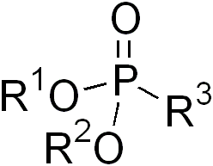
Am solvent extraction
Tributylphosphate (TBP)
  Am extracted from neutral or low acid solutions with high nitrate
  Am(VI)
    Oxidation with (NH₄)₁₀P₂W₁₇O₆₁ to stabilize Am(VI)
    100 % TBP from 1 M HNO₃
      Separation factor 50 from Nd
  Am separation from lanthanides
    1 M ammonium thiocyanate aqueous phase
Dibutyl butylphosphonate (DBBP)
  Phosphonate functional group
  Similar to TBP, stronger extractant of Am
Trialkylphophine oxide (TRPO)
  Increase in basicity of P=O functional group from TBP to DPPB to TRPO
  Am and Cm extraction from 1-2 M HNO₃
  30 % TRPO in kerosene
    Am, Cm, tetravalent Np and Pu, hexavalent U extracted
      Actinides stripped with 5.5 M HNO₃ (Am fraction)
    TRPO with C₆-C₈ alkyl group

Slide 7
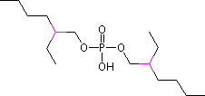
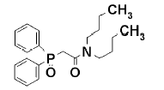
Am solvent extraction
Bis(2-ethylhexyl)phosphoric acid (HDEHP)
  Has been used to Am separation
  Part of TALSPEAK
    Extracts lanthanides stronger that actinides
    TALSPEAK components
      Bis(2-ethyl-hexyl)phosphoric acid (HDEHP)
      HNO₃
      DTPA
      Lactic acid
Carbamoylphosphine oxide (CMPO)
  Synthesized by Horwitz
    Based on DHDECMP extractions
      Recognized functional group, simplified ligand synthesis
      Purified by cation exchange
  Part of TRUEX
    TRUEX (fission products)
      0.01 to 7 M HNO₃
      1.4 M TBP
      0.2 M Diphenyl-N,N-dibutylcarbamoyl phosphine oxide (CMPO)
      0.5 M Oxalic acid
      1.5 M Lactic acid
      0.05 M DTPA
HDEHP
CMPO

Slide 8
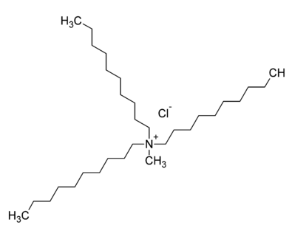

Am solvent extraction
Tertiary amine salt
  Low acid, high nitrate or chloride solution
    (R₃NH)₂Am(NO₃)₅
Quaternary ammonium salts (Aliquat 336)
  Low acid, high salt solutions
    Extraction sequence of Cm<Cf<Am<Es
  Studies at ANL for process separation of Am
Amide extractants
  (R₁,R₂)N-C(O)-CR₃H-C(O)-N(R₁R₂)
    Diamide extractant
    Basis of DIAMEX process
  N,N’-dimethyl-N,N’-dibutyl-2-tetradecyl-malonamide (DMDBTDMA)
    DIAMEX with ligand in dodecane with 3-4 M HNO₃
      Selective extraction over Nd

Slide 9
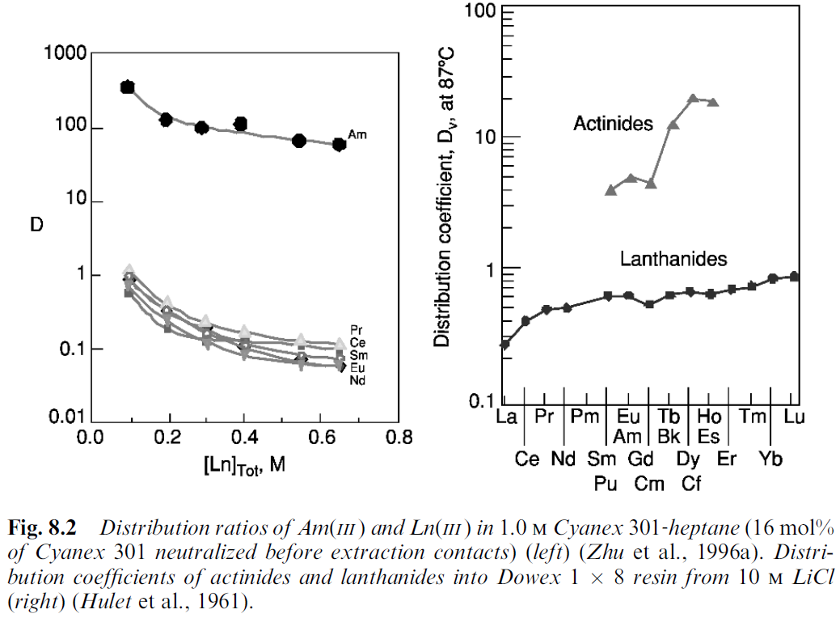
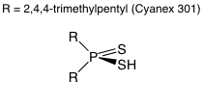
Am/Ln solvent extraction
Extraction reaction
  Am³⁺+2(HA)₂→AmA₃HA+3 H⁺
    Release of protons upon complexation requires pH adjustment to achieve extraction
      Maintain pH greater than 3
Cyanex 301 stable in acid
  HCl, H₂SO₄, HNO₃
    Below 2 M
Irradiation produces acids and phosphorus compounds
  Problematic extractions when dosed 10⁴ to 10⁵ gray
New dithiophosphinic acid less sensitive to acid concentration
  R₂PSSH; R=C₆H₅, ClC₆H₄, FC₆H₄, CH₃C₆H₄
    Only synergistic extractions with, TBP, TOPO, or tributylphosphine oxide
    Aqueous phase 0.1-1 M HNO₃
    Increased radiation resistance
Distribution ratios of Am(III ) and Ln(III ) in 1.0 M Cyanex 301‐heptane (16 mol% of Cyanex 301 neutralized before extraction contacts)

Slide 10
Ion exchange separation Am from Cm
LiCl with ion exchange achieves separation from lanthanide
Separation of tracer level Am and Cm has been performed with displacement complexing chromatography
  DTPA and nitrilotriacetic acid in presence of Cd and Zn as competing cations
  displacement complexing chromatography method is not suitable for large scale
Ion exchange has been used to separate trace levels of Cm from Am
  Am, Cm, and lanthanides sorbed to a cation exchange resin at pH 2
    Separation of Cm from Am was performed with 0.01 % ethylenediamine-tetramethylphosphonic acid at pH 3.4 in 0.1 M NaNO₃
    separation factor of 1.4
Separation of gram scale quantities of Am and Cm by cation and anion exchange
  use of α-hydroxylisobutyrate or diethylenetriaminepentaacetic acid as an eluting agent or a variation of eluant composition by addition of methanol to nitric acid
    best separations were achieved under high pressure conditions
      separation factors greater than 400
Distribution
coefficients of actinides and lanthanides into Dowex 1 8 resin from 10 M LiCl

Slide 11
Extraction chromatography
Mobile liquid phase and stationary liquid phase
  Apply results from solvent extraction
    HDEHP, Aliquat 336, CMPO
      Basis for Eichrom resins
      Limited use for solutions with fluoride, oxalate, or phosphate
    DIPEX resin (Eichrom)
      Bis-2-ethylhexylmethanediphosphonic acid on inert support
      Lipophilic molecule
        Extraction of 3+, 4+, and 6+ actinides
      Strongly binds metal ions
        Need to remove organics from support
  Variation of support
    Silica for covalent bonding
    Functional organics on coated ferromagnetic particles
      Magnetic separation after sorption

Slide 12
Am separation and purification
Precipitation method
  Formation of insoluble Am species
    AmF₃, K₈Am₂(SO₄)₇ , Am₂(C₂O₄)₃, K₃AmO₂(CO₃)₂
      Am(V) carbonate useful for separation from Cm
      Am from lanthanides by oxalate precipitation
        Slow hydrolysis of dimethyloxalate
        Oxalate precipitate enriched in Am
        50 % lanthanide rejection, 4 % Am
  Oxidation of Am(VI) by K₂S₂O₈ and precipitation of Cm(III)
Pyrochemical process
  Am from Pu
    O₂ in molten salt, PuO₂ forms and precipitates
    Partitioning of Am between liquid Bi or Al and molten salts
      K_{d} of 2 for Al system
    Separation of Am from PuF₄ in salt by addition of OF₂
      Formation of PuF₆, volatility separation

Slide 13
Cm separation and purification: Similar to Am
Solvent extraction
  Organic phosphates
    Function of ligand structure
      Mixed with 6 to 8 carbon chain better than TBP
  HDEHP
    From HNO₃ and LiCl
  CMPO
    Oxidation state based removal with different stripping agent
  Extraction of Cm from carbonate and hydroxide solutions, need to keep metal ions in solution
    Organics with quaternary ammonium bases, primary amines, alkylpyrocatechols, β-diketones, phenols
Ion exchange
  Anion exchange with HCl, LiCl, and HNO₃
    Includes aqueous/alcohol mixtures
    Formation of CmCl₄⁻ at 14 M LiCl
      From fluorescence spectroscopy
Precipitation
  Separation from higher valent Am
    10 g/L solution in base
    Precipitation of K₅AmO₂(CO₃)₃ at 85 °C
    Precipitation of Cm with hydroxide, oxalate, or fluoride

Slide 14
Review
Understand the differences and techniques for
  Solvent extraction
  Ion exchange
  Electrochemistry
  Volatility
Understand how oxidation state influences different separation methods
Understand the different mechanisms in solvent extraction
Compare and contrast specific actinide separation
Describe the components of an ion exchange resin
Provide a ion exchange and solvent extraction separation for Am from the other actinides.
Provide the basic of electrochemical and IL separations.
  What is the differences in these methods?

Slide 15
Questions
Describe the concepts in solvent extraction?
What is third phase formation in solvent extraction?
  How can it be controlled?
  What is third phase important to understand for actinide separations?
  How can it be exploited in chemistry?
Describe a volatility based separation for Pu.

Slide 16
PDF Quiz
Respond to Lecture 9 PDF quiz
Provide comment on blog

